Slide 1
Sketching Techniques
Design and Modeling

Slide 2
Common Uses of Sketching
Brainstorm
Communicate
Document
Notes:
In the engineering field, sketches are often used to brainstorm ideas and to solve problems. Many times they are used to communicate ideas to other people for better understanding or explanation of an object. Sketches are also used for documentation.

Slide 3
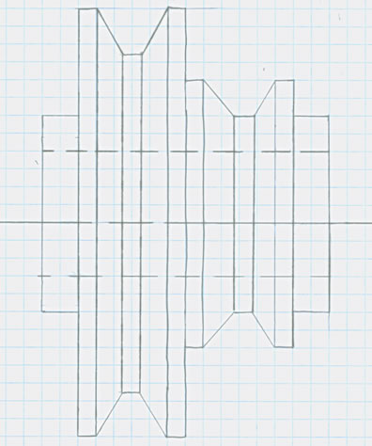
Advantages of Hand Sketching
Convenient
Inexpensive
Notes:
Creating and using hand sketches provides several advantages. Sketches are convenient and can be created almost anywhere, plus they are inexpensive. Few additional materials are needed. Only pencil and paper (or a napkin) is required to create a sketch. In many cases, you may be brainstorming and simply documenting your ideas. In other cases, you may be trying to communicate technical information. In this presentation we will be talking about techniques commonly used in technical sketching.

Slide 4
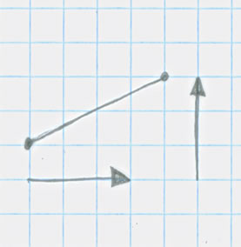
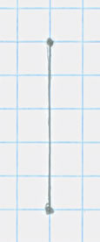
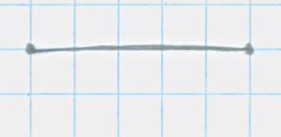
Sketching Techniques
Lines
Inclined Line
Vertical Line
Horizontal Line
Rise
Run
Notes:
There are some skills that we need to discuss, such as vertical lines, horizontal lines, plus inclined or slanted lines. To create any of the lines shown, it is important to plot or locate two points, the start and end points, before you attempt to draw the line.

Slide 5



Sketching Techniques
Sketching a Line
1)
2)
3)
Notes:
When sketching a line, first, plot the start and end points. Next, draw short line segments between the two points so that you have an idea of where the line will be drawn. Finally, darken the smaller lines so that one solid line appears between the two points. You will repeat the same process when drawing vertical or inclined lines.

Slide 6
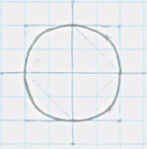
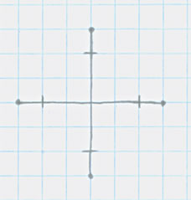
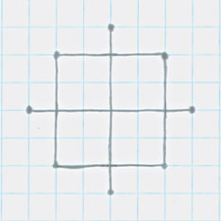
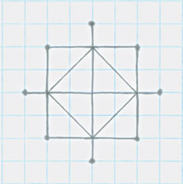
Sketching Techniques
Sketching a Circle
1) Set up the
diameter
2) Square in the
diameter
3) Sketch
diagonals
Notes:
To sketch a circle, you will complete a five step process. In step one, create a horizontal and vertical line the size of the desired diameter of the circle. Make sure the two lines intersect each other at the midpoints of the lines. For step two, sketch a square the size of the desired diameter. Make all horizontal and vertical lines the same length to ensure a true square shape. In step three, create diagonal or slanted lines connecting the four original diameter size marks together.

Slide 7
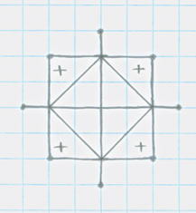
Sketching Techniques
Sketching a Circle
4) Identify triangle
centers
5) Sketch arcs
Notes:
Now in step four, create a mark at the center location for each of the triangles. In the last step, sketch curved lines using the original diameter marks and the center marks just created to complete a perfect circle.

Slide 8

Alphabet of Lines
Construction
Object
Hidden
Center
Notes:
There are four basic types of lines used when creating sketches. In the following slides, you will be shown each type of line and how it is used on a sketch.
Construction lines are lightly drawn lines that you can use to help you draw other lines properly. If you hold your paper an arm’s length away, you should not be able to see construction lines. They can even be erased after the object is sketched.
Object lines are thick lines used to show visible edges of an object. In many situations, construction lines are converted to object lines.
Hidden lines are used to show interior details not visible from the a particular view of the object.
Center lines are used to define the center of the arcs, circles, or symmetrical parts. They are drawn half as thick as object lines.

Slide 9
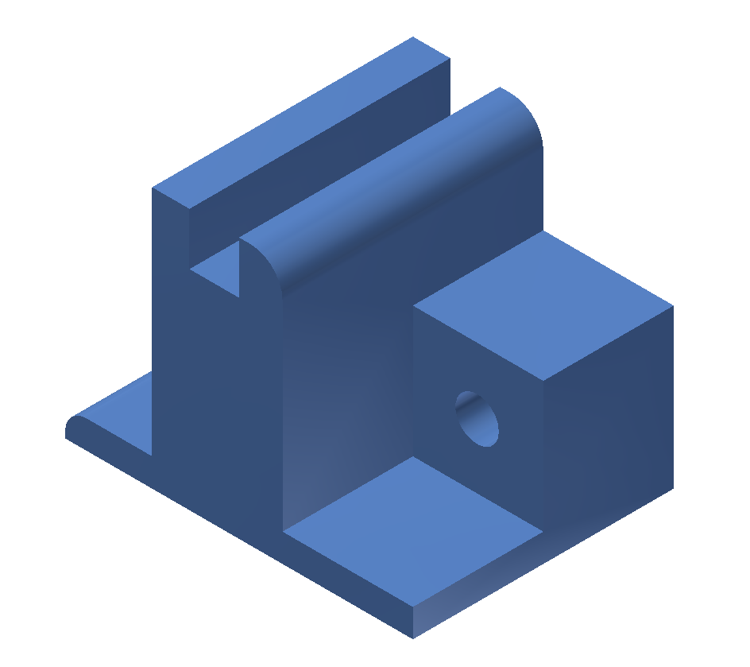
Alphabet of Lines
Notes:
Consider this object in the following sketches that illustrate different types of lines.

Slide 10
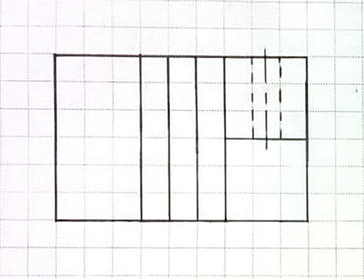

Top View
Object Line
Hidden Line
Center Line
Notes:
This view represents the part as seen from the top of the object. The line of sight is indicated by the red arrow.
Which line is an object line?
[Click to reveal an answer.]
Which line is a hidden line?
[Click to reveal an answer.] In this view hidden lines is used to show the edges of a hole not visible from the top of the object.
Which line is a center line?
[Click to reveal an answer.] In this view the center line is used to identify the center of the hole in the object.

Slide 11
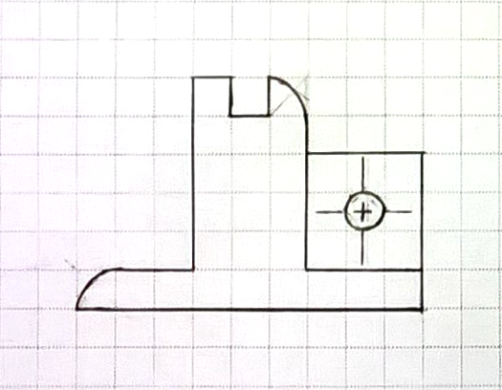
Front View
Object Line
Center Line
Center Line
Notes:
This view represents the part as seen from the front of the object. The line of sight is indicated by the red arrow.
Which line is an object line?
[Click to reveal an answer.]
Which line is a center line?
[Click to reveal an answer.]

Slide 12
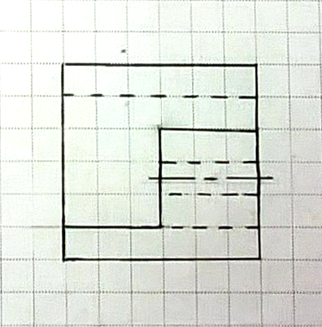
Right View
Hidden Line
Center Line
Object Line
Notes:
This view represents the part as seen from the right side of the object. The line of sight is indicated by the red arrow.
Which line is an object line?
[Click to reveal an answer.]
Which line is a hidden line?
[Click to reveal an answer.] In this view hidden lines are used to indicate the edges of the through hole as well as the bottom of the slot that can not be seen when viewing the part from the right side.
Which line is a center line?
[Click to reveal an answer.]

Slide 13
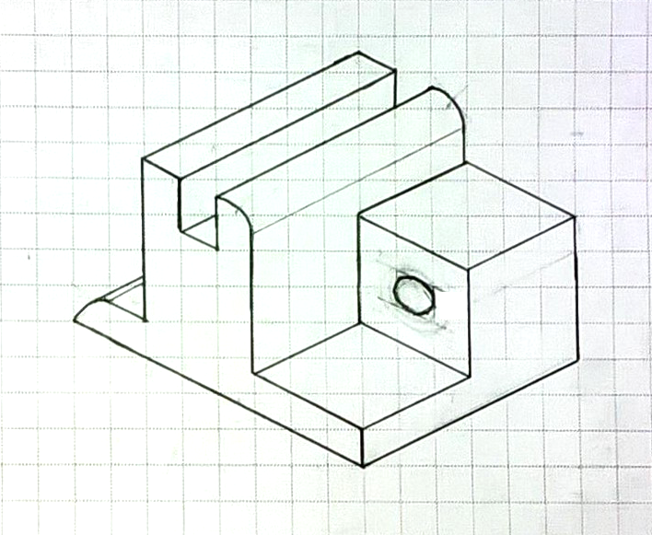
Isometric View
Object Line
Construction Line
Notes:
Which line is an object line?
[Click to reveal an answer.]
Which line is a construction line?
[Click to reveal an answer.]

Slide 14
Image Resources
Microsoft, Inc. (2008). Clip Art. Retrieved October 20, 2008, from http://office.microsoft.com/en-us/clipart/default.aspx

