Slide 1
Dimensioning
Design and Modeling

Slide 2
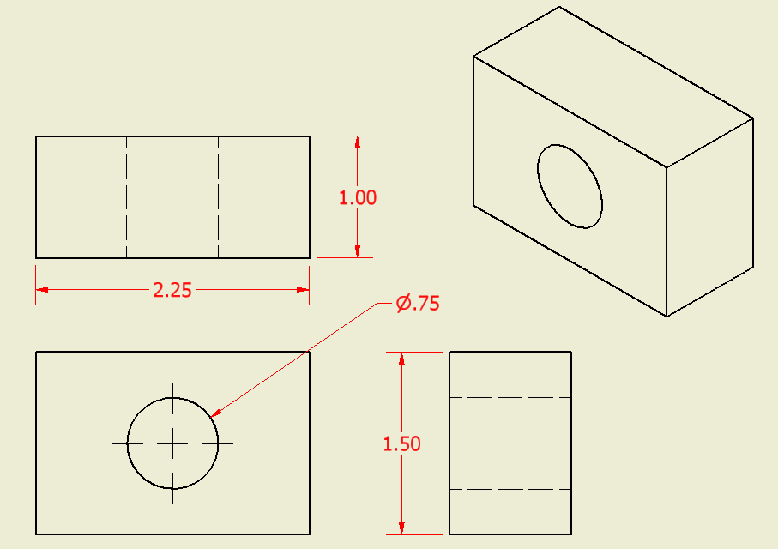
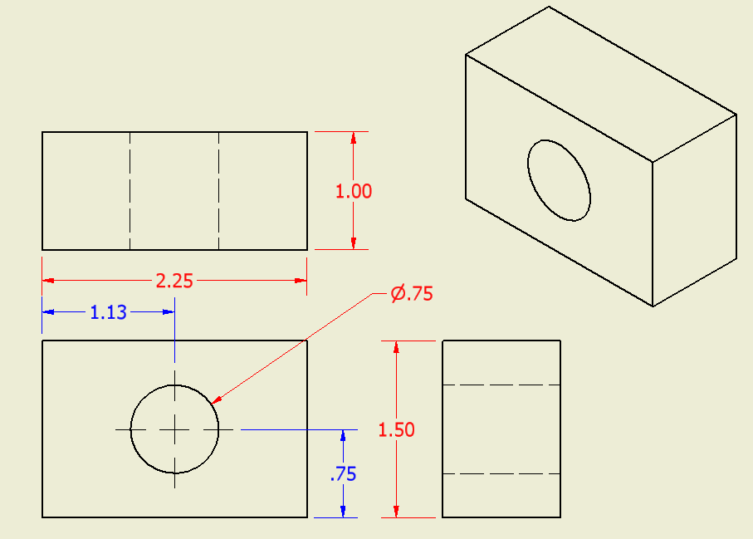
Why Dimension?
Engineers, designers, and engineering technologists need to know
Size
and
Location of all features
Notes:
Size dimensions describe the size of each geometric feature.
With respect to linear dimensions, size dimensions are sometimes referred to as overall dimensions and will tell the viewer the overall width, height, and depth of an object.
Location dimensions show the location of each geometric feature within an object or view.
Location dimensions tell the viewer where edges occur inside an object view.

Slide 3
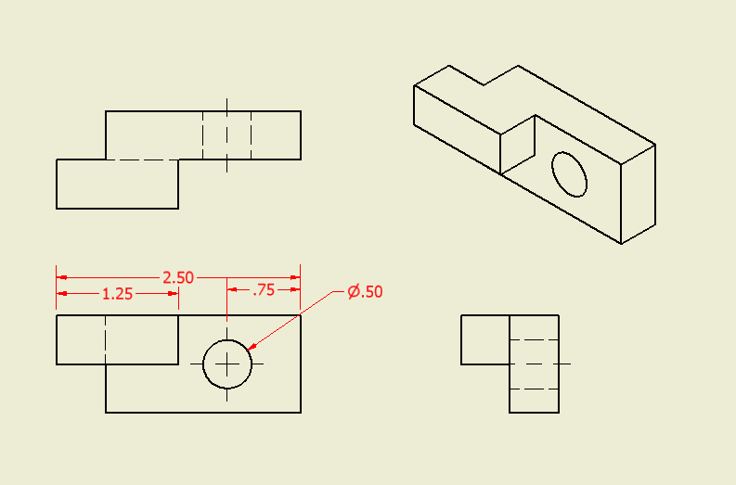
Dimension Completely
Width
Notes:
The students should notice the location of the dimensions and how the largest are on the top or outside and they become gradually smaller as you get closer to the object.

Slide 4
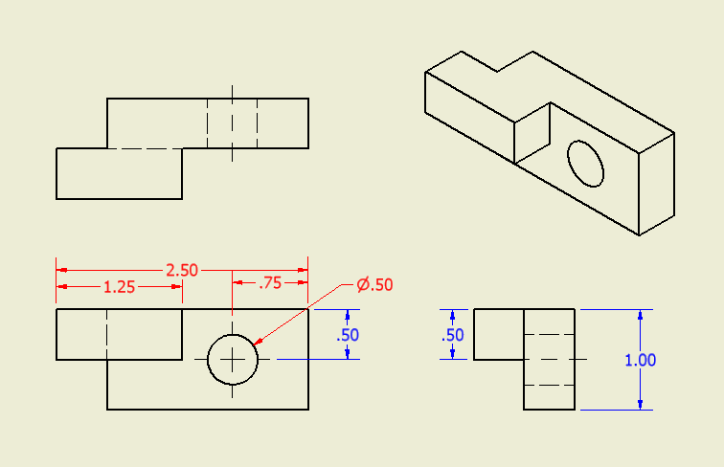
Dimension Completely
Width
Height
Notes:
Talk to the students about over-dimensioning and what is meant by over-dimensioning.

Slide 5
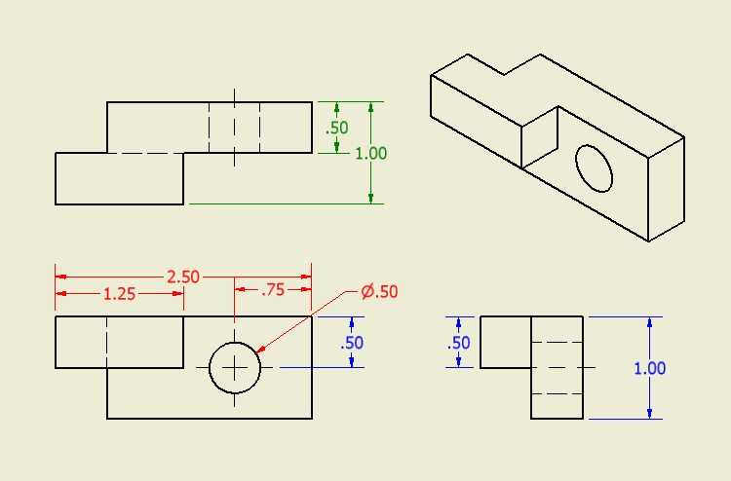
Dimension Completely
Width
Height
Depth
Notes:
Point out the location dimensions for the circle.
Center mark and centerline bisectors are needed to show where the center of a circle is.

Slide 6
Dimension Line Types
Dimension Line
Extension Line
Leader Line
Notes:
Dimension Line - Thin lines capped with arrowheads which may be broken along their length to provide space for the dimension numerals. Whenever possible try to center the dimension between the arrows.
Extension Line - Thin lines used to establish the extent of a dimension. Extension lines should not touch the object. Notice the space between the object line and the extension line, and between the center line and the extension line in the hole location dimension. Extension lines can be shared between individual dimension lines.
Leader Line - Lines that are thin and used to connect a specific note to a feature.
Point out the symbol for diameter.

Slide 7
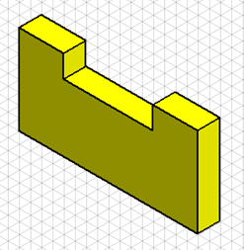
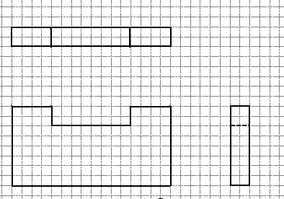
Your Turn to Practice
¼ in. scale or 4 squares = 1 in.
Notes:
Give students time to complete this in Activity 1.4.5 Dimensioning before going on to the next slide.
Tell students that it is not good dimensioning practice to dimension to a hidden line.
A future presentation will describe the guidelines associated with dimensioning.

Slide 8
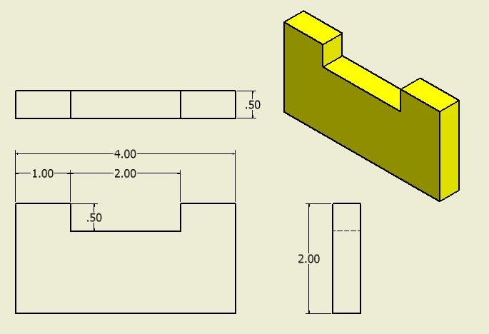
Check Your Answers
Notes:
Orthographic graph paper is removed to better show dimensions.

Slide 9
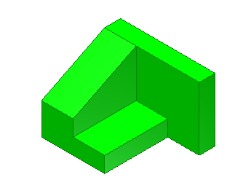
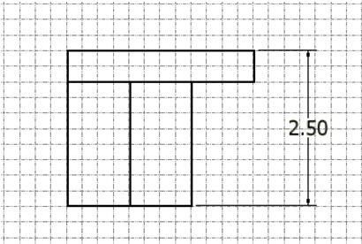
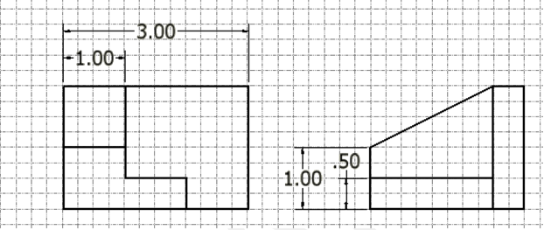
Where are the Missing Dimensions?
¼ in. scale or 4 squares = 1 in.
Notes:
Give students time to complete this in Activity 1.4.5 Dimensioning before going on to the next slide.

Slide 10
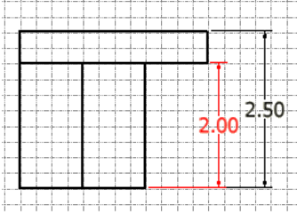
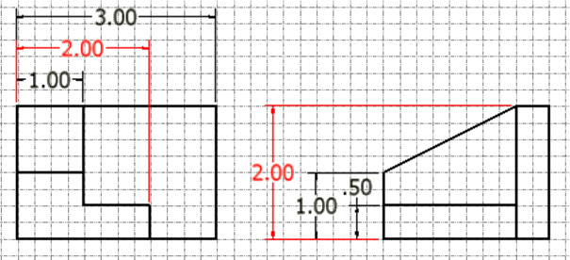
Here They Are
Notes:
Notice that the dimension value is all the same, but the dimension is measuring the size of different features. This is NOT duplicating a dimension. Often you will have the same value, but you will dimension different features.

