Slide 1
Dimensioning Guidelines
Design and Modeling
Notes:
There are dozens of rules, dos and don’ts, and guidelines associated with dimensioning. The purpose of this presentation is to introduce those guidelines that are most critical. These 8 rules have been taken from the IED curriculum as the guidelines that we most want middle school students to recognize. You may use the IED presentation on Dimension Guidelines if you want to include the 16 guidelines that they discuss.

Slide 2
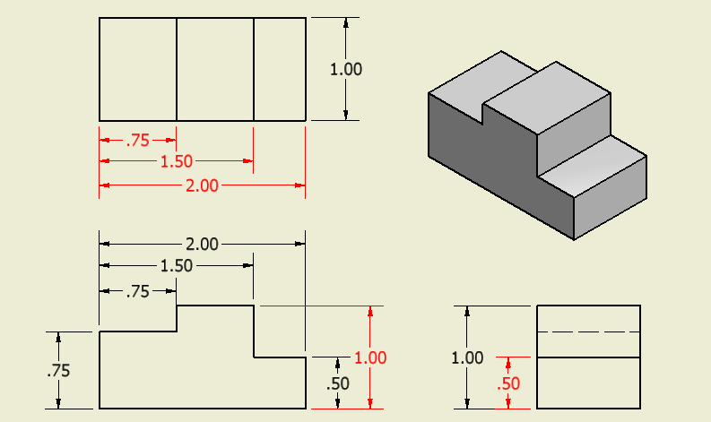
1. Dimensions should NOT be duplicated, nor should the same information be given in two different ways.
Incorrect

Slide 3
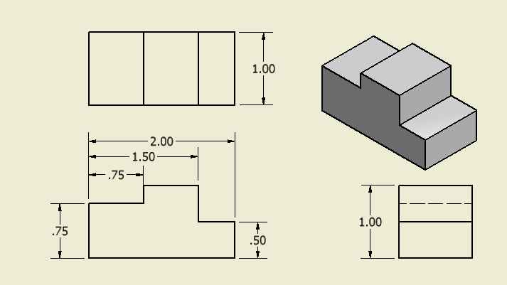
1. Dimensions should NOT be duplicated, nor should the same information be given in two different ways.
Correct
Notes:
References:
Pg 337 Engineering Drawing and Design 3rd Edition by David Madsen, et. al.
Pg 109 Fundamentals of Modern Drafting by Paul Wallach
Pg 425 Technical Drawing 9th Edition by Frederick Giesecke, et. al.
Pg 701 Technical Graphics Communication 3rd Edition by Gary Bertoline & Eric Wiebe

Slide 4
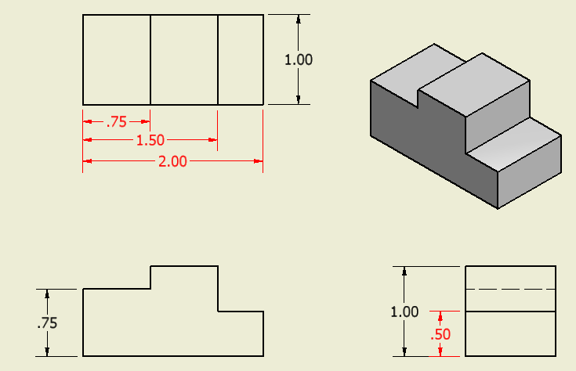
2. Dimensions should be attached to the view that best shows the contour of the feature to be dimensioned.
Incorrect
Notes:
References:
Pg 342 Engineering Drawing and Design 3rd Edition by David Madsen, et. al.
Pg 405 & 425 Technical Drawing 9th Edition by Frederick Giesecke, et. al.
Pg 698, 700, 701-703 Technical Graphics Communication 3rd Edition by Gary Bertoline & Eric Wiebe
It should be noted that the 2.00 inch dimension would be appropriately located if placed on the top view, but the front view is preferred because it is supposed to provide the most information about an object’s geometry.

Slide 5
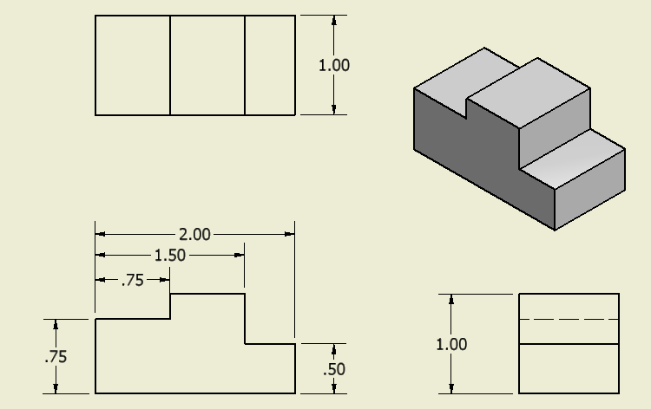
2. Dimensions should be attached to the view that best shows the contour of the feature to be dimensioned.
Correct
Notes:
References:
Pg 342 Engineering Drawing and Design 3rd Edition by David Madsen, et. al.
Pg 405 & 425 Technical Drawing 9th Edition by Frederick Giesecke, et. al.
Pg 698, 700, 701-703 Technical Graphics Communication 3rd Edition by Gary Bertoline & Eric Wiebe
It should be noted that the 2.00 inch dimension would be appropriately located if placed on the top view, but the front view is preferred because it is supposed to provide the most information about an object’s geometry.

Slide 6
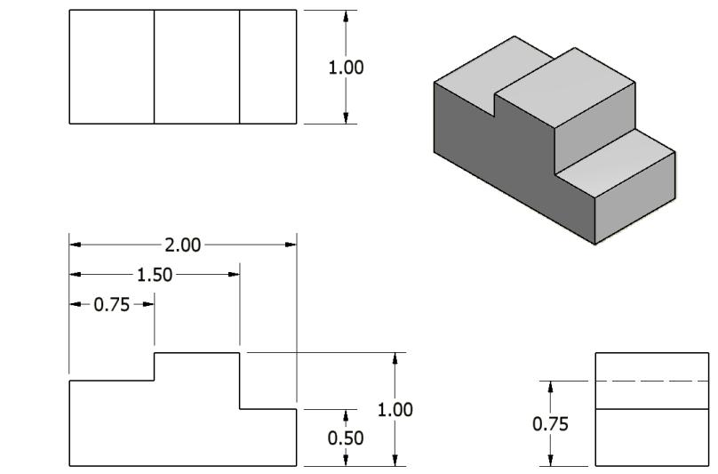
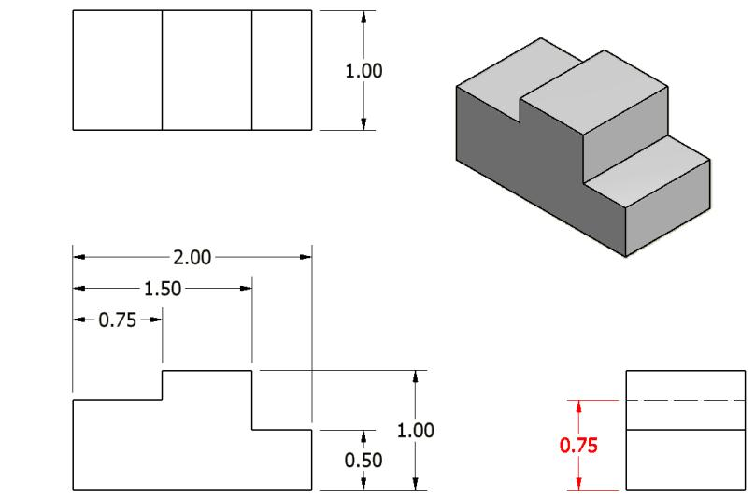
3. Whenever possible, avoid dimensioning to hidden lines.
Incorrect
Notes:
References:
Pg 342 Engineering Drawing and Design 3rd Edition by David Madsen, et. al.
Pg 134 Fundamentals of Modern Drafting by Paul Wallach
Pg 426 Technical Drawing 9th Edition by Frederick Giesecke, et. al.
Pg 703 Technical Graphics Communication 3rd Edition by Gary Bertoline & Eric Wiebe

Slide 7
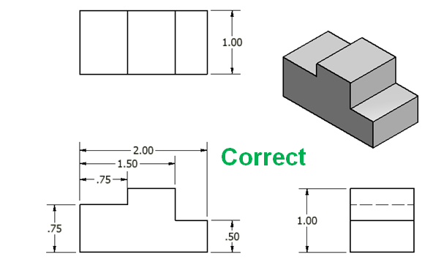
3. Whenever possible, avoid dimensioning to hidden lines.
Notes:
References:
Pg 342 Engineering Drawing and Design 3rd Edition by David Madsen, et. al.
Pg 134 Fundamentals of Modern Drafting by Paul Wallach
Pg 426 Technical Drawing 9th Edition by Frederick Giesecke, et. al.
Pg 703 Technical Graphics Communication 3rd Edition by Gary Bertoline & Eric Wiebe

Slide 8
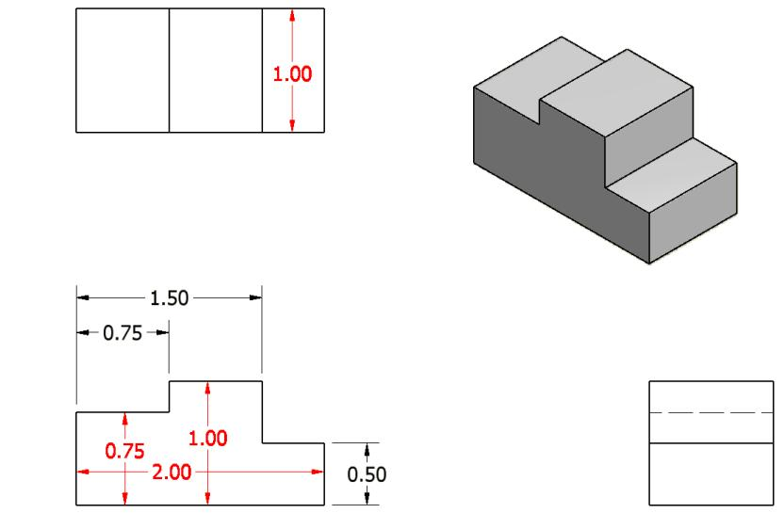
4. Avoid dimensioning over or through the object.
Incorrect
Notes:
References:
Pg 342 Engineering Drawing and Design 3rd Edition by David Madsen, et. al.
Pg 394, 404, 426 Technical Drawing 9th Edition by Frederick Giesecke, et. al.
Pg 692 Technical Graphics Communication 3rd Edition by Gary Bertoline & Eric Wiebe

Slide 9
4. Avoid dimensioning over or through the object.
Notes:
References:
Pg 342 Engineering Drawing and Design 3rd Edition by David Madsen, et. al.
Pg 394, 404, 426 Technical Drawing 9th Edition by Frederick Giesecke, et. al.
Pg 692 Technical Graphics Communication 3rd Edition by Gary Bertoline & Eric Wiebe

Slide 10
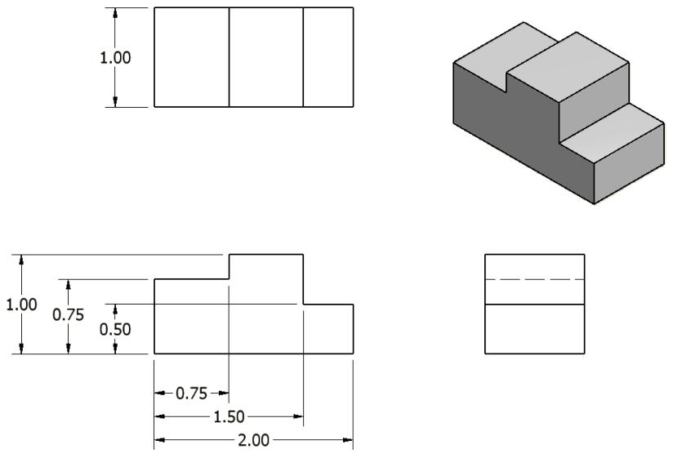
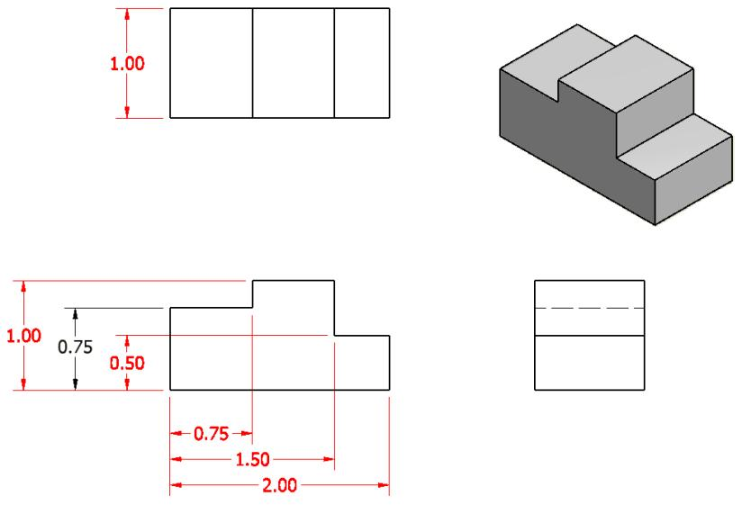
5. Whenever possible, locate dimensions between adjacent views.
Incorrect
Notes:
References:
Pg 342 Engineering Drawing and Design 3rd Edition by David Madsen, et. al.
Pg 108 Fundamentals of Modern Drafting by Paul Wallach
Pg 426 Technical Drawing 9th Edition by Frederick Giesecke, et. al.

Slide 11
5. Whenever possible, locate dimensions between adjacent views.
Notice this dimension is not between the views, but this is a better placement
than dimensioning to the hidden line in the right side view.
Notes:
References:
Pg 342 Engineering Drawing and Design 3rd Edition by David Madsen, et. al.
Pg 108 Fundamentals of Modern Drafting by Paul Wallach
Pg 426 Technical Drawing 9th Edition by Frederick Giesecke, et. al.

Slide 12
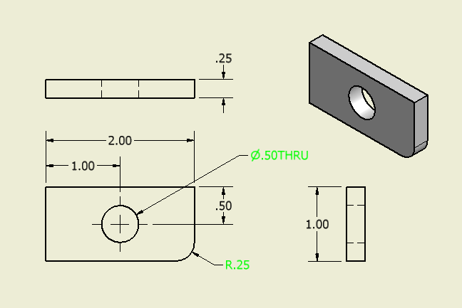
6. In general, a circle is dimensioned by its diameter and an arc by its radius.
Notes:
References:
Pg 344-345, 347-349 Engineering Drawing and Design 3rd Edition by David Madsen, et. al.
Pg 131, 138-139 Fundamentals of Modern Drafting by Paul Wallach
Pg 402-403, 410-411, 427 Technical Drawing 9th Edition by Frederick Giesecke, et. al.
Pg 687-688, 695-696 Technical Graphics Communication 3rd Edition by Gary Bertoline & Eric Wiebe

Slide 13
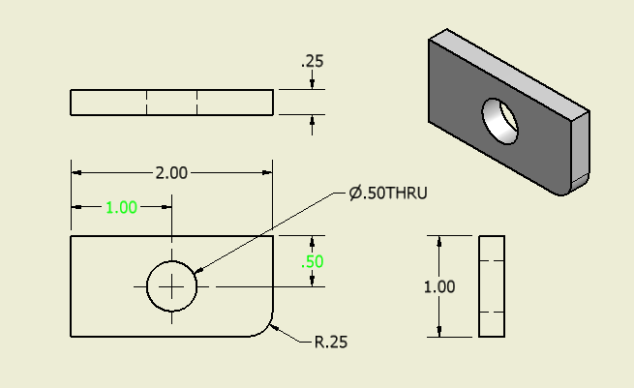
7. Holes are located by their centerlines, which may be extended and used as extension lines.
Notes:
References:
Pg 44, 340 Engineering Drawing and Design 3rd Edition by David Madsen, et. al.
Pg 393-394, 426 Technical Drawing 9th Edition by Frederick Giesecke, et. al.
Pg 690-691 Technical Graphics Communication 3rd Edition by Gary Bertoline & Eric Wiebe

Slide 14
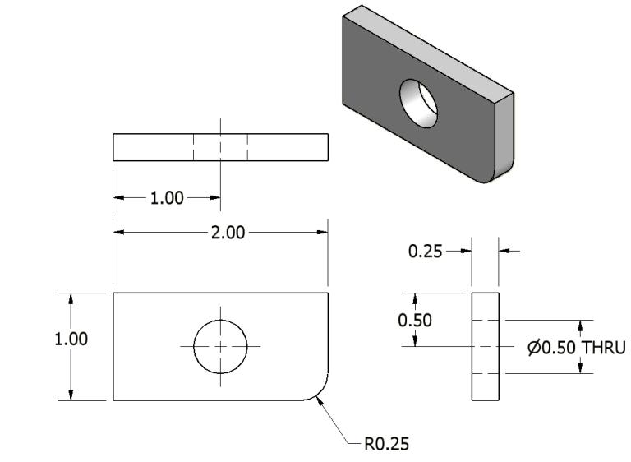
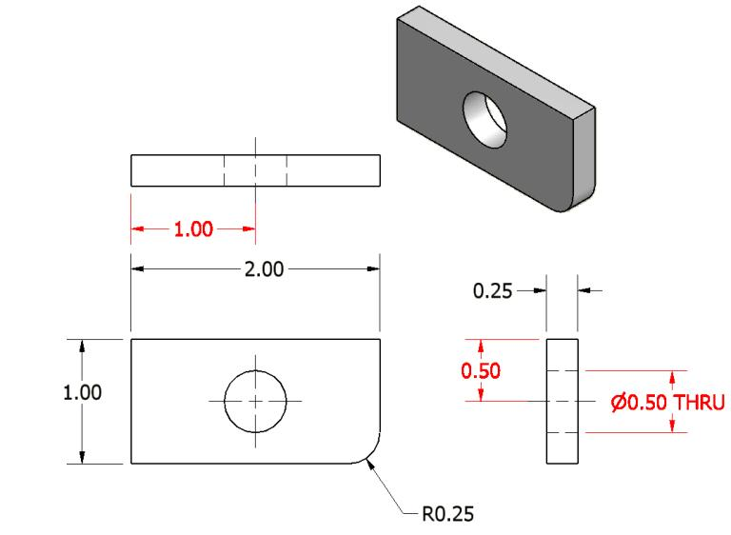
8. Holes should be located and sized in the view that shows the feature as a circle.
Incorrect
Notes:
References:
Pg 351 Engineering Drawing and Design 3rd Edition by David Madsen, et. al.
Pg 109 Fundamentals of Modern Drafting by Paul Wallach
Pg 411, 427 Technical Drawing 9th Edition by Frederick Giesecke, et. al.
Pg 693 Technical Graphics Communication 3rd Edition by Gary Bertoline & Eric Wiebe

Slide 15
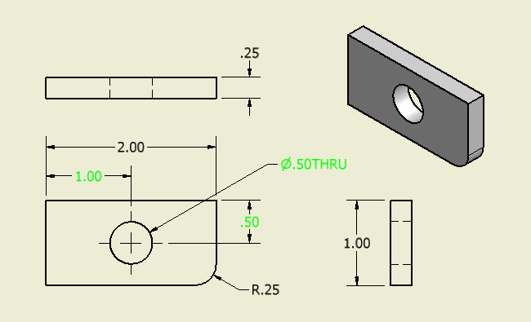
8. Holes should be located and sized in the view that shows the feature as a circle.
Correct
Notes:
References:
Pg 351 Engineering Drawing and Design 3rd Edition by David Madsen, et. al.
Pg 109 Fundamentals of Modern Drafting by Paul Wallach
Pg 411, 427 Technical Drawing 9th Edition by Frederick Giesecke, et. al.
Pg 693 Technical Graphics Communication 3rd Edition by Gary Bertoline & Eric Wiebe
Note: The top view was removed because it is not needed to completely communicate the object’s geometry.

